Slide 1

Analysis of the segmentation of Indian World-class standard services Hotel & Restaurants
Data Analysis
By- Jeeten Patel

Slide 2

Introduction

Slide 3
Introduction
India (Hindi: Bhārat), officially the Republic of India, is a country in South Asia. It is the seventh-largest country by area, the second-most populous country, and the most populous democracy in the world.
Problem
To Analyze the segmentation of world-class standard services hotel & restaurants located across India
To understand what is popular around them and what they have to offer to tourist who is contemplating to choose stay.
This analysis is not only limited to tourist but also investors seeking business opportunities can take advantage as it provides an analysis of the surrounding within a 1km radius of the Hotel.
Interest
How lively and vibrant each of the locations around the hotel with its features will be when compared to other
Will assist tourist or if anyone interested in a potential location for a business opportunity.

Slide 4
Data acquisition and cleaning

Slide 5
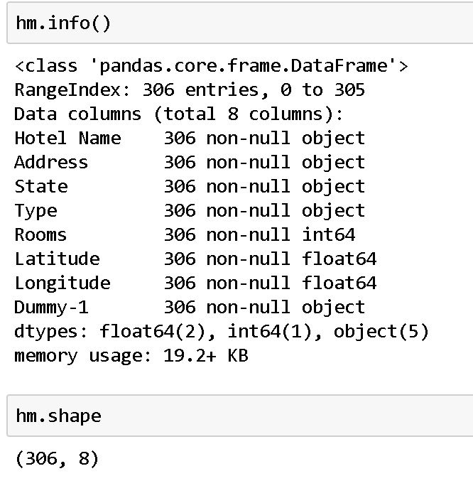
Data acquisition and cleaning
Data source- https://data.gov.in/resources/approved-hotelsrestaurantsair-catering-unitstime-share-resortsapartmentsconvention (CSV format)
The above data has been published by the Ministry of Tourism for Classifying/ Re-classifying Hotels under various categories at the project
The Hotel are specifically classified in five premier categories: Heritage Grand, Heritage Classic, Heritage Basic, 5 Star Deluxe, 5 Star and 4 Star
The Nominatim library from geocoders.geopy package has been used to find the Longitude and Latitude of Hotel Locations.
The irrelevant data columns: Phone, Fax, Email ID and Website have been removed.
After data cleaning, there are 306 samples and 7 features in the given data frame along with one dummy column named as Dummy-1 for analysis purpose.

Slide 6
Exploratory Data Analysis

Slide 7
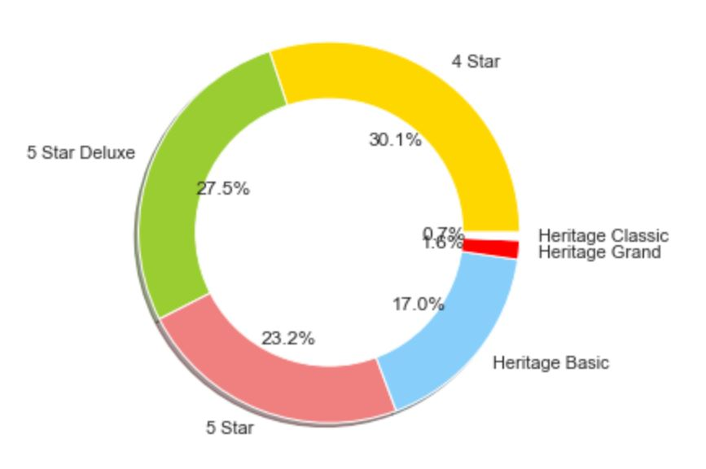
Distribution of Hotels: Pie-Chart Distribution
The number of 4-Star Hotels are found to be highest in India out of these five segments. While 5-Star Deluxe are 2nd highest.
There are very low number of top premier Hotel segment i.e. Heritage Classic and Heritage Grand 0.7% and 1.6% respectively while comparing to other segments.

Slide 8
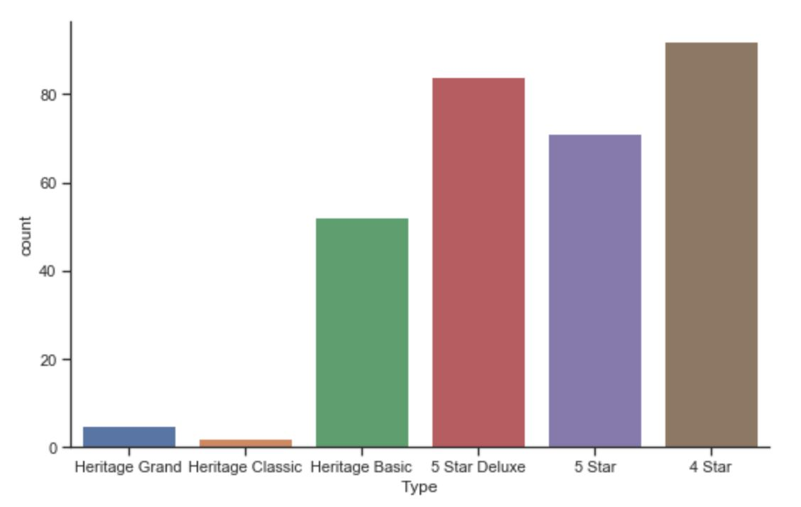
Distribution of Hotels: Bar-Chart Distribution
x-axis: Hotel Type
y-axis: Number of Hotels

Slide 9
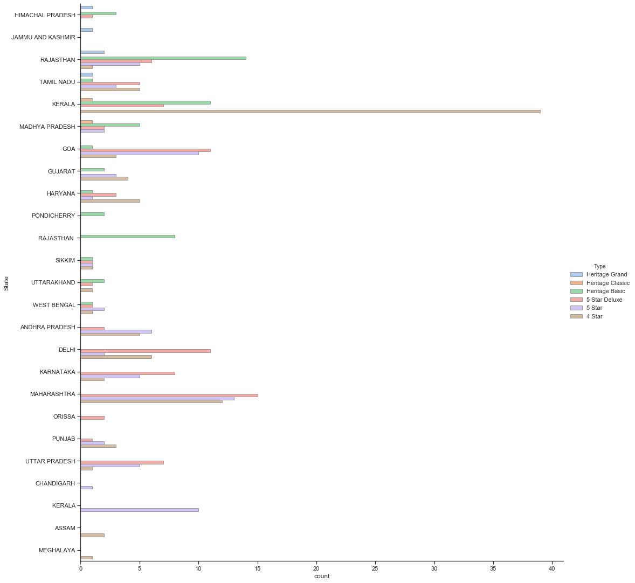
Distribution of Hotels: State-wise Distribution
x-axis: State
y-axis: Number of Hotels

Slide 10
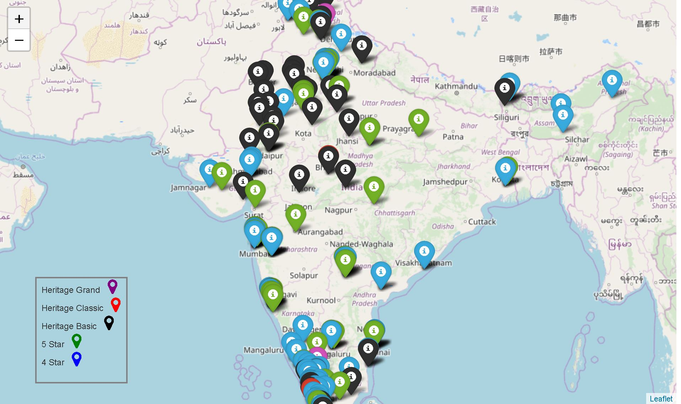
Distribution of Hotels: Folium Map Distribution
We find that South India is heavily concentrated with premier Hotels. On other hand, as we move from west to east India number significantly reduces due to several geographic and financial reasons which are not part of this analysis.

Slide 11
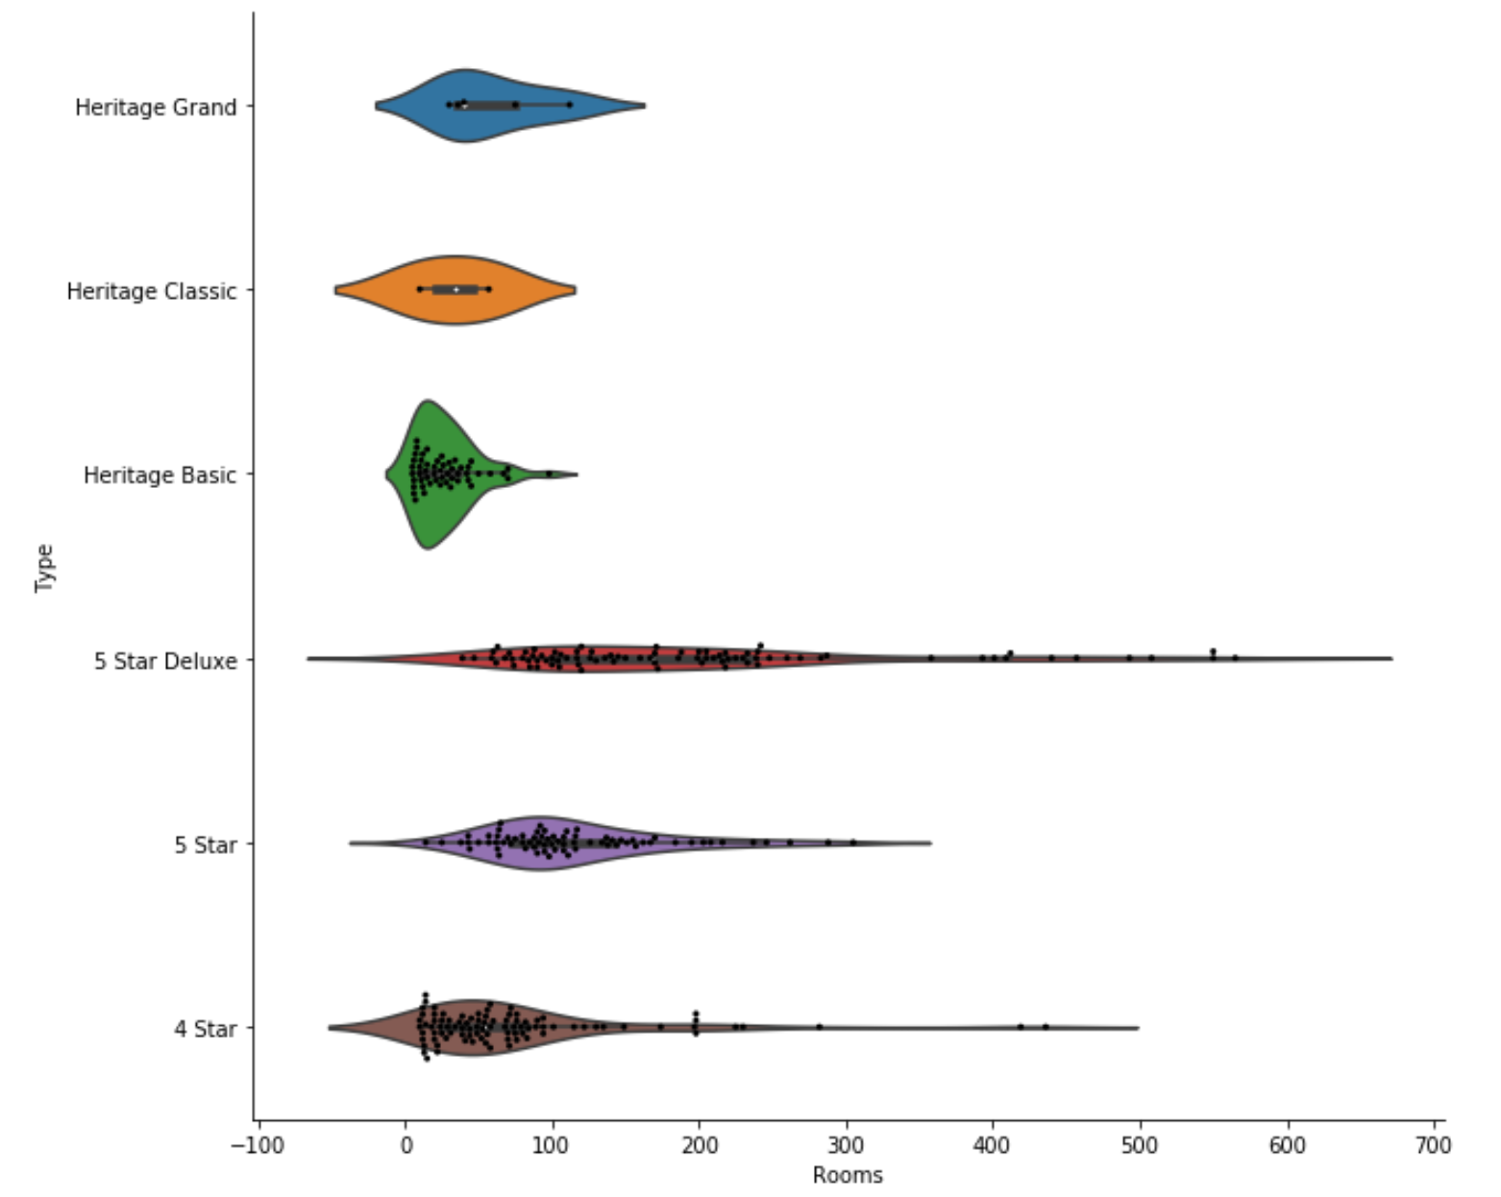
Distribution of Rooms: Box-Plot Distribution
Violin plot is a method to visualize the distribution of numerical data of different variables. It is similar Box Plot but with a rotated plot on each side, giving more information about the density estimate on the y-axis.
Mean:
4 Star 75
5 Star 115
5 Star Deluxe 195
Heritage Basic 27
Heritage Classic 33
Heritage Grand 59

Slide 12
K-means Clustering: Algorithm

Slide 13
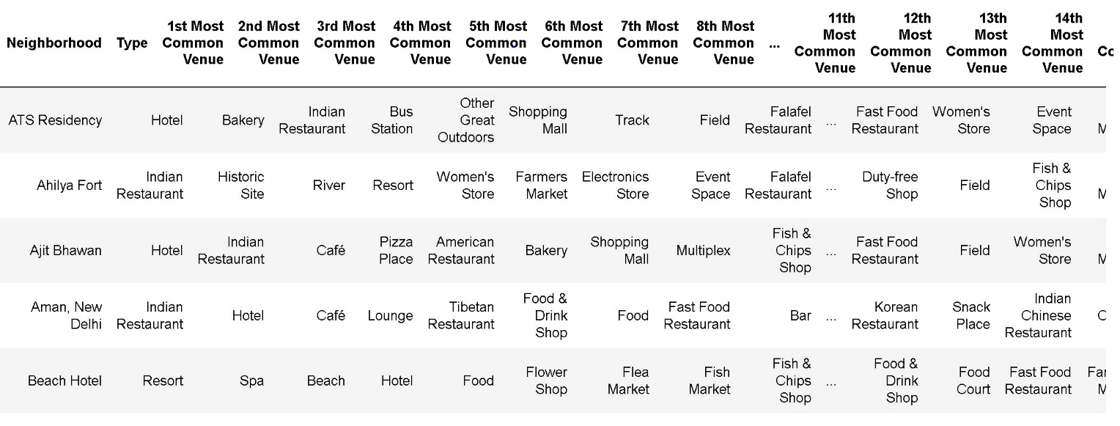
Foursquare API Analysis
Top 20 common venue in the radius 1000 meter for each Hotel location found using the Foursquare API
In summary 272 unique categories were returned by Foursquare API.

Slide 14
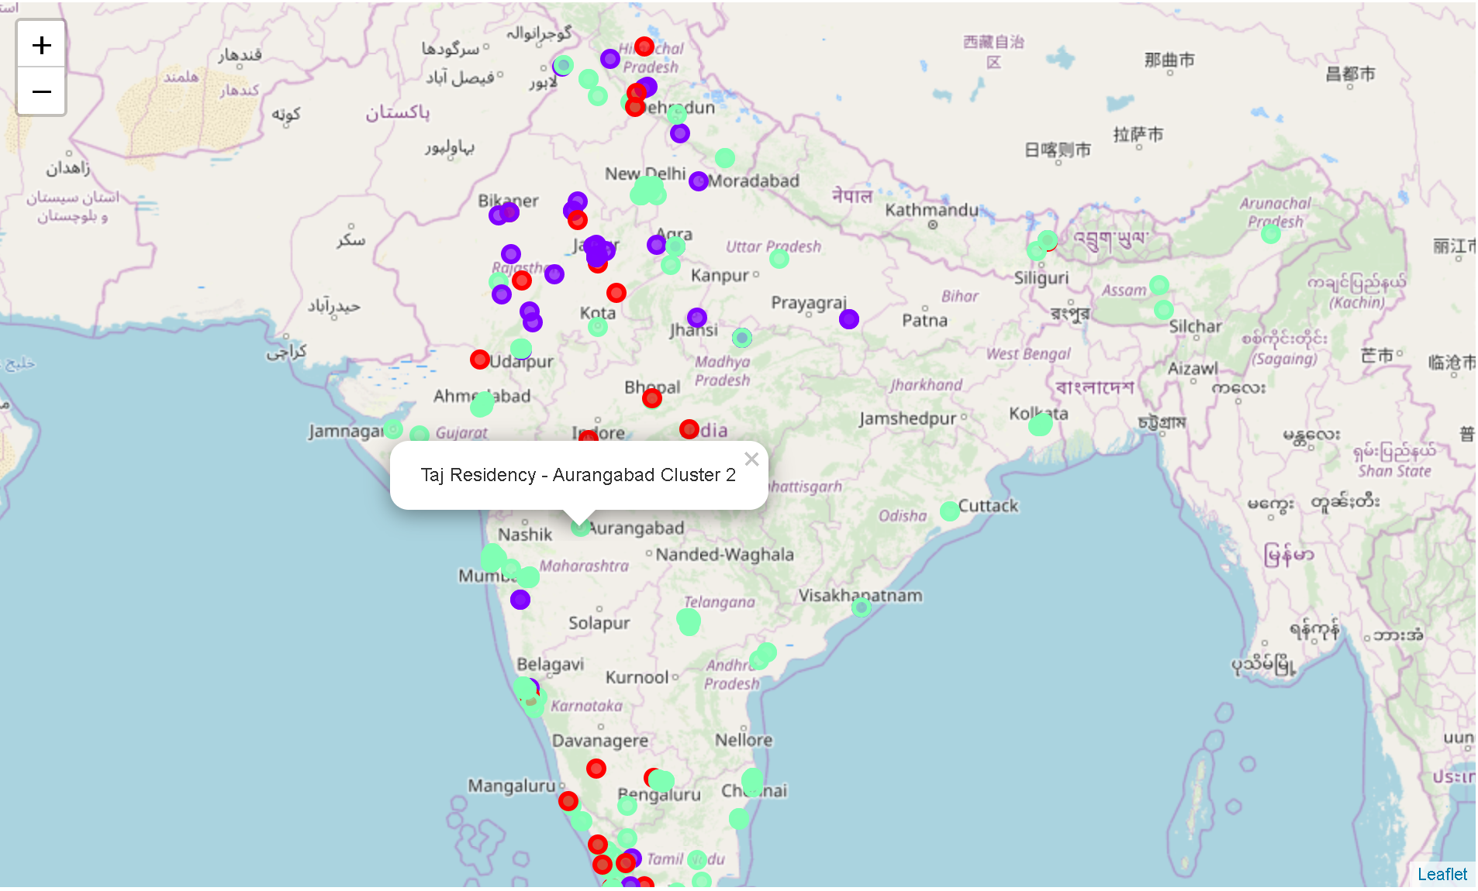
Run k-means to cluster the neighbourhood into 3 clusters
K-means clustering is one of the simplest and popular unsupervised machine learning algorithms. A cluster refers to a collection of data points aggregated together because of certain similarities. The ‘means’ in the K-means refers to averaging of the data; that is, finding the centroid.

Slide 15

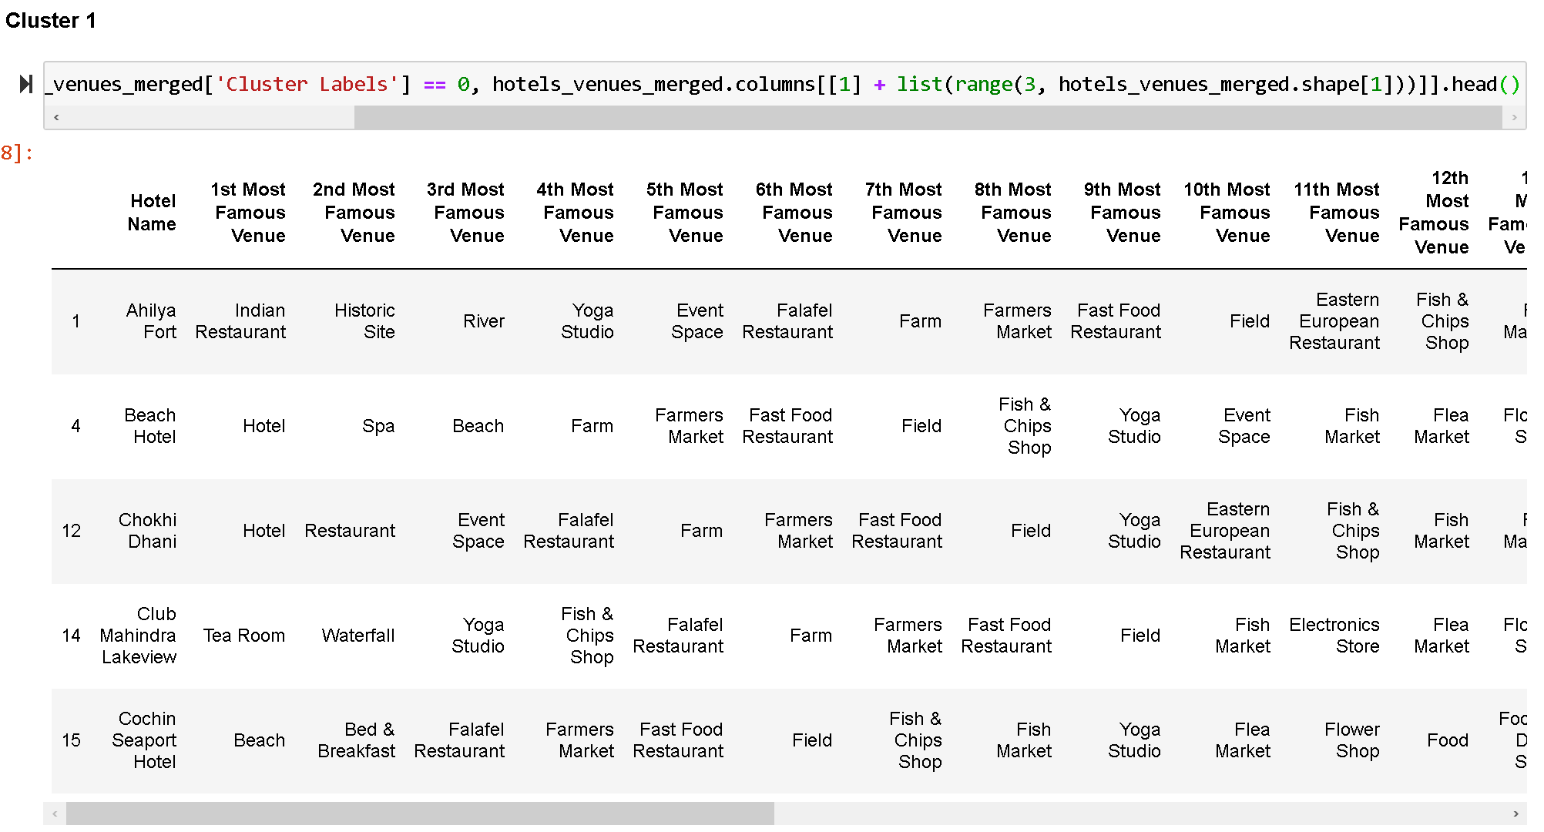
Run k-means to cluster the neighbourhood into 3 clusters
For this analysis K is set to be 3 clusters. K can be set higher based on objective. Based on analysis these 3 clusters will provide similar supportive, vibrant and unique ambience around the hotel. If a tourist want similar experience they may choose from same cluster and vice versa.

Slide 16
Conclusions
The relationship between Number of Hotels & Type of Hotel and Number of rooms & Type of Hotel as discussed in Exploratory Data Analysis are significant.
Analysis it further can give meaning insights. As per someone with business seeking objective can provide competitive edge.
Folium Map provides significant observations how number of premier Hotels diminish from West to East.
K-means algorithm provides three clusters based on similarities of supportive, vibrant and unique ambience around the hotel.
By setting K to be higher further analysis can be done as it depends on objective of user as shown below.
This analysis was done with top 20 most common venues this can be further increased. Instead of using most common venues one can use highest rated venues or something else.
One can also visualize State-wise or for city using Folium Map. Same analysis can be done for 1-star, 2-star, 3-star hotels.
Future directions

Slide 17



Thank You
April Hansson
Jeeten Patel
jeeten.patel@iiml.org

